Slide 1

SusSheP – how to increase sustainability and profitability of European Sheep Production?
69th Annual Meeting of the European Federation of Animal Science
Dubrovnik, Croatia, 27-31 August 2018
Morgan-Davies, C*., Creighton, P., Boman, I.A., Blichfeldt, T., Krogenaes, A., Lambe, N., Wall, E., Padiou, T., Diskin, M.G., Meade, K.G., McHugh, N., Druart, X., Fair, S.
* claire.morgan-davies@sruc.ac.uk

Slide 2
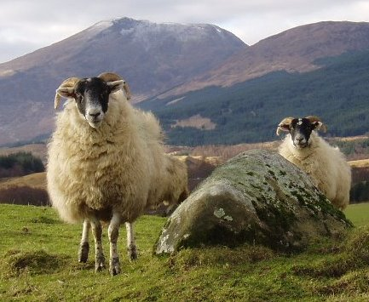
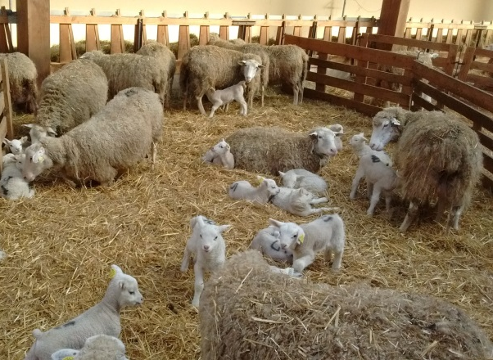
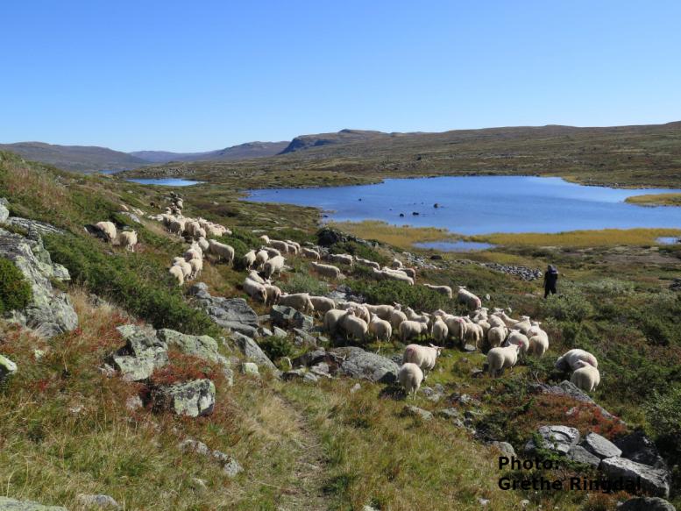
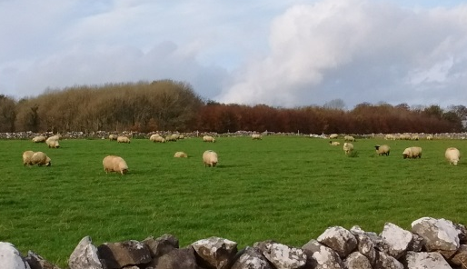
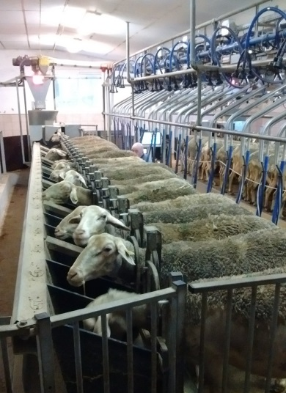
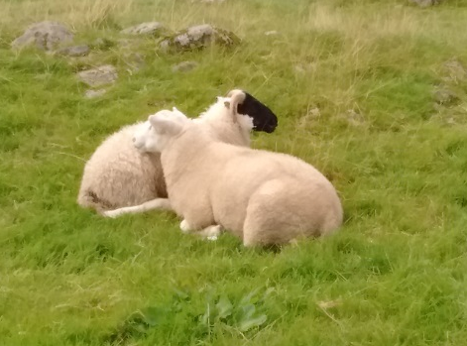
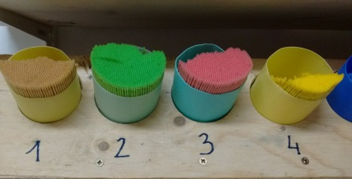
Sheep Production in Europe
European Sheep Production:
89 million sheep in Europe (EEA)
Environmentally sustainable & welfare friendly practices
Profitable & labour efficient
But….
Unproductive until 1st lamb crop, only 4 crops of lamb
Varied
  production
  breeds
  management systems

Slide 3
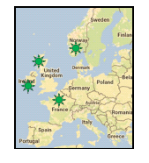

SusSheP
Sustainable Sheep Production
3 year ERA-NET European project (2017-2020), with 4 European countries: Norway, France, Ireland & UK.
Overall aim: to increase the sustainability and profitability of European Sheep Production by addressing key industry focused problems.
Key objectives :
Provide new genetic tools for farmers to increase longevity of ewes
Quantify labour input and carbon hoofprint in contrasting sheep systems
Develop more socially acceptable methods of AI, looking at ewe breed effects
Assess farmers’ attitudes to change
Notes:
Mention that we look at the 3 pillars of sustainability – production, environment and societal when giving the overall aim
Explain attitudes to change – with a survey across the 4 countries and an LCA approach to some of the sheep prduction systems studied, as well as workshops.

Slide 4
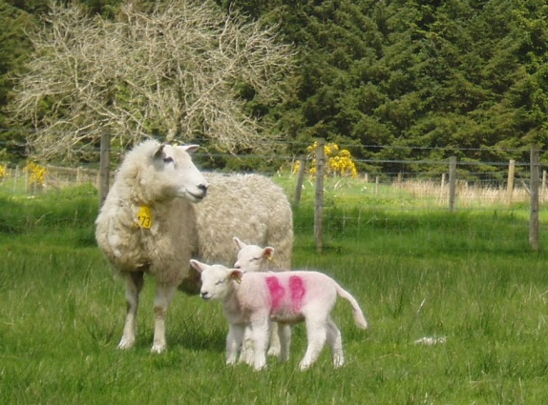
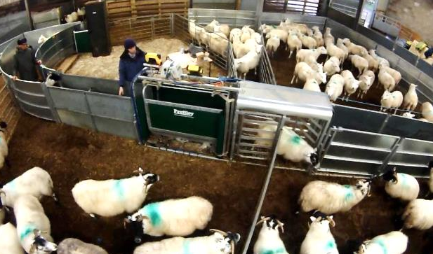
Labour - Purpose & Goals
To characterise labour input and carbon hoofprint of different sheep production systems (SPSs)
  20 focus flocks:
    With/without PLF:
      4 in the UK, 2 in Ireland
    Prolific/non-prolific breed:
      4 in Ireland, 2 in Norway
    With/without high genetic gain
      Indexes (4 in the UK)
      AI (4 in France)

Slide 5

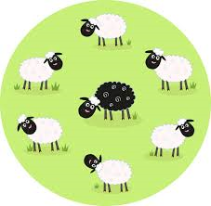
Labour - Methods
Labour recording:
  on sample days during the sheep year (~10-12 days) – Go Pros
  Common questionnaire on farm info and labour
  Industry benchmark
Classification:
  15 main tasks
  Sub-tasks
Carbon hoofprint:
  Agricalc ©
  kgCO2e/kg output
    Whole farm
    flock
Mating
Mid-pregnancy scanning
Pre-lambing
Lambing
8 weeks after lambing
Shearing
Weaning
Sales
Post mating

Slide 6
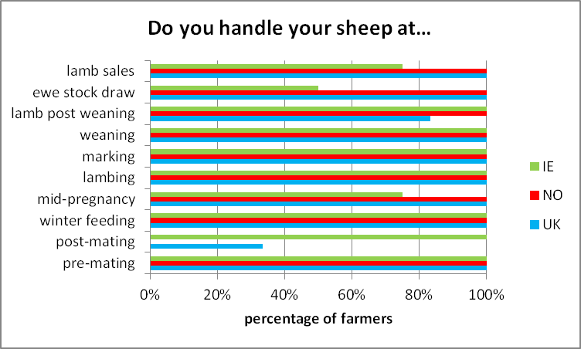
Labour - some initial results
Labour profiles between countries (only 12 flocks so far):
Notes:
6 from Scotland, 2 from No, 4 from Ireland

Slide 7
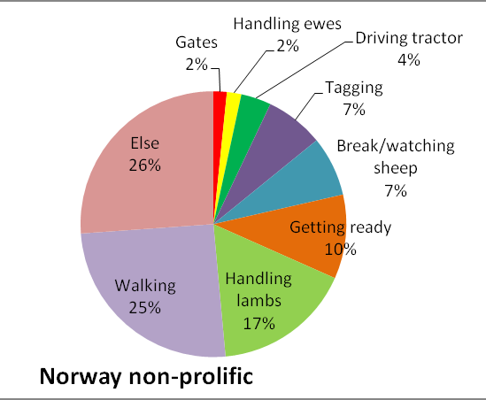
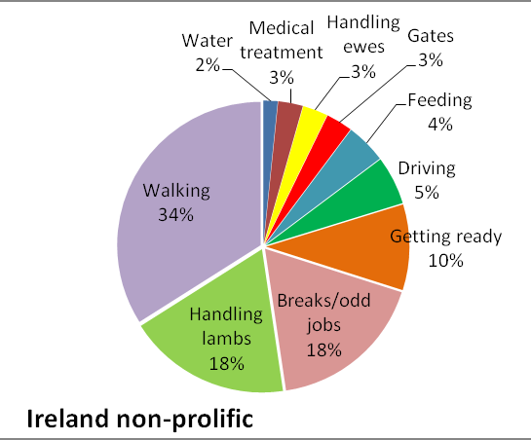
Labour - some initial results
Tasks between systems: at lambing
Similarities/differences between systems
Quantify labour difference between systems
Agricalc ©

Slide 8

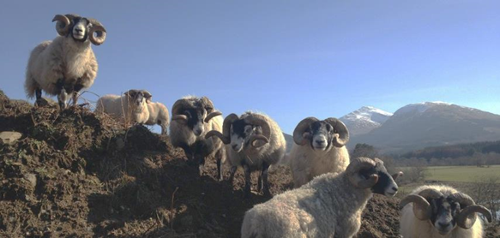
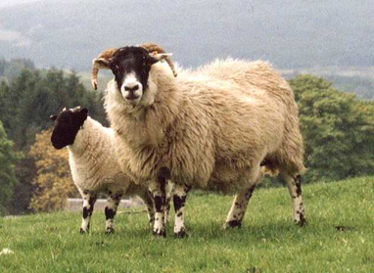
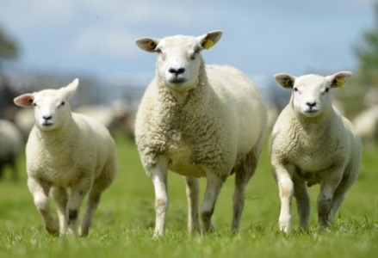
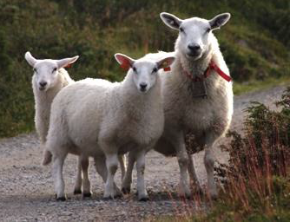
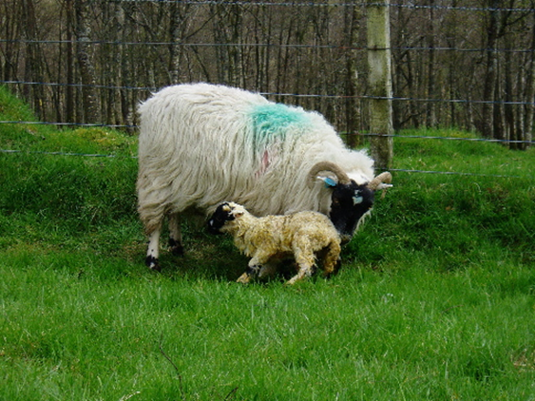
SusSheP – Ewe Longevity
Important trait economically
Purpose of this work
  Investigate genetic factors controlling longevity under different production systems.
  Incorporate findings into future national breeding programmes
  Breeding healthier, longer living ewes that can perform well in a range of diverse environments

Slide 9
SusSheP – Ewe Longevity
Countries involved:
  Ireland, Norway, UK
Main definition of longevity being investigated across all countries
  Age at last recorded lambing event
Differences in the main reasons for culling between countries/systems also being investigated:
  Mastitis = Ireland & Norway
  Tooth Loss = UK
Ann.mclaren@sruc.ac.uk
Notes:
just a couple of points for when you discuss. Good to point out that we are limited in the longevity trait we chose due to differences in levels of recording between different performance recording programmes (countries / systems) – we wanted to look at one that could be investigated across all datasets. UK was specifically a hill sheep system where tooth loss most common.

Slide 10

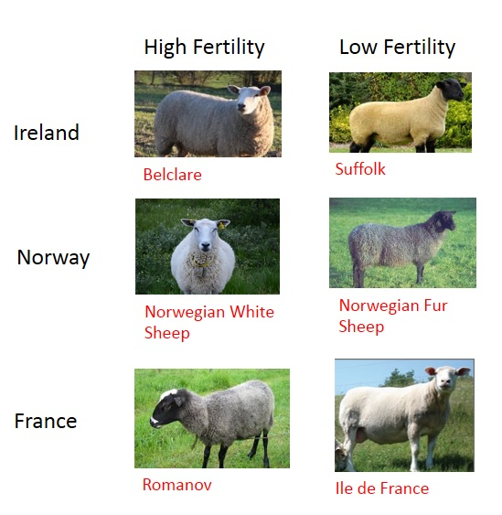
Some information on the cervical AI – ewe breed effect?
Ireland/Norway/France
n = 30 ewes per breed
Induced and Natural Oestrus
Follicular & Luteal phases
X3 replicates
Cervical Mucus
Weight, Viscosity and Colour
Proteome/Glycome
Cervical Tissue and Anatomy
Laura.Parreno@ul.ie
Notes:
Maybe introduce this slide by saying that in Norway farmers are doing cervical AI with frozen-thawed semen themselves and achieve a pregnancy rate of approx. 60% to a natural oestrus. This is the only place worldwide which can achieve these levels of pregnancy rates and work in Ireland over the last 10-15 years has identified that it is due to the breed of the ewe and more specifically due to improved sperm transport across the cervix of some breeds than others. The focus of SusSheP is to characterise the biology of the cervix of ewe breeds across Norway, Ireland and France.
What follows are results from the cervical anatomy btw Belclare & Suffolk

Slide 11
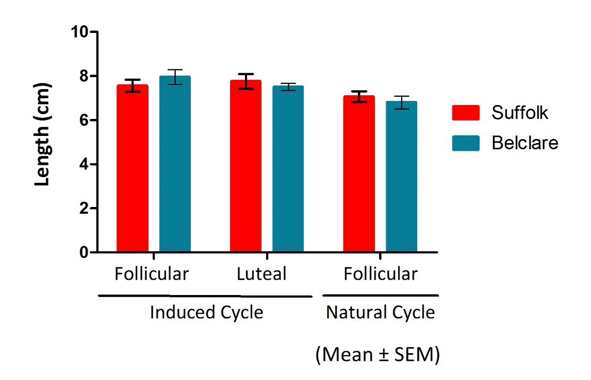
Length of the cervix
Effect of breed (P >0.05)
Effect of type cycle (P< 0.05)
n= 30 ewes/breed
Laura.Parreno@ul.ie
Notes:
The fact that neither of these ‘gross measurements’ differ between Suffolk and Belclare breeds is a positive for our project as it points to more subtle difference in cervical physiology between the breeds. Thus why we are looking at gene expression in the cervical tissue as well as cervicovaginal mucus proteins and glycan composition.

Slide 12
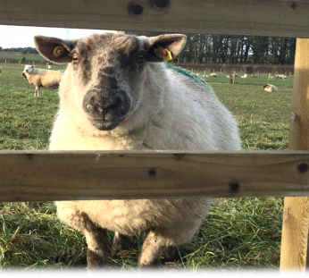
Conclusions
  Still work in progress
  Preliminary results promising
    Longevity in national maternal breeding indexes
    Effects of changing management on labour
    Identify most carbon efficient production systems
    Alleviate societal concerns around AI
    In partnership with farmers – surveys & workshops
Notes:
Mention that we look at the 3 pillars of sustainability – production, environment and societal

Slide 13


Acknowledgments
All my SusSheP colleagues & students
EU funders
UK funder
….. and the Norwegian, British, French and Irish farmers for agreeing to be filmed!

